Slide 1


Mechanical Installation

Slide 2

Lesson Goal
To learn how to achieve
A good installation and
A reliable system

Slide 3
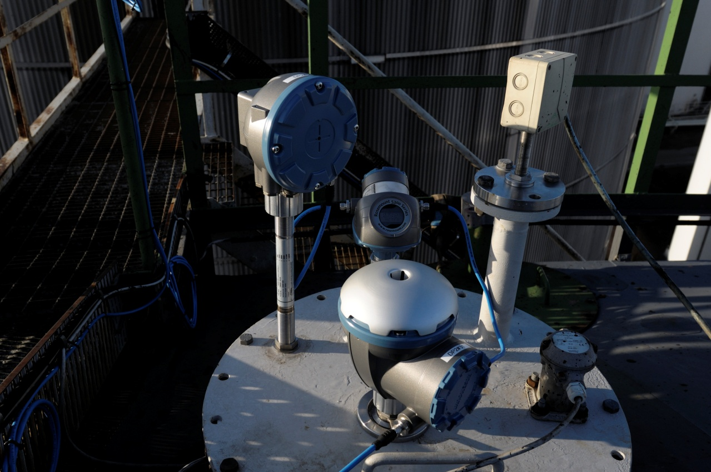
Contents
Mechanical
Tank
Gauge
Electrical
EX zones
Wires
Connections
Layout
Notes:
Picture of a typical installation.
Where is the gauge mounted? Close to wall (explain why)
Look at the cabling. Why do they look like that? (Explain)
What to think of regarding the electrical installation. Before, after and during the installation (See picture)

Slide 4
API Standards
American Petroleum Institute
Construction and handling standards / procedures
Used as a reference for Inventory Tank Gauging
Rosemount Tank Gauging Products
Are all built to meet and fulfill the API-standards
API documents can be ordered from
http://api-ep.api.org/
Notes:
What kind of standard do Rosemount follow? API=Motsvarigheten till Sveriges Provnings Institut
See slide!

Slide 5
API Standards
Chapter 3-Section 1B - Automatic Tank Gauging
Paragraph 3.6.1:
“… mounting location have minimal vertical movement with respect to the tank reference..”
Paragraph 3.6.1.4:
“…should be located away from tank inlets, tank outlets and tank mixers or in a still pipe to minimize the effect of turbulence and swirl”
Paragraph 3.6.1.5:
“ .. should be located near the gauging hatch so that its accuracy can be easily verified..”
Paragraph 3.6.2.2:
“.. the centerline of still pipe should be located between 450mm-800mm from tank shell of the tank..”
Notes:
Go thru the four paragraph's. Explain each and one of them.

Slide 6
Tank Construction
The tank itself should be built to meet the requirements in the API standard.
If a tank becomes unstable the optimum measuring performance can not be reached
Lack of accuracy
Unstable reading
Unstable roof
Bulging walls
(Hydrostatic pressure)
Notes:
Most common conditions for a unstable tank reference height > Unstable roof + Bulging walls.

Slide 7
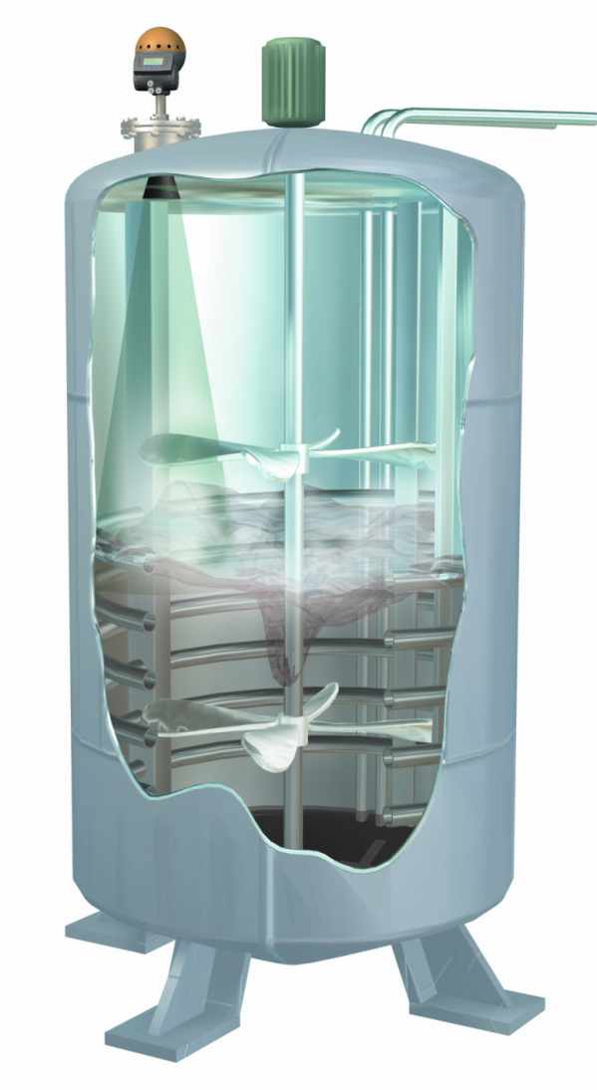
Tank Conditions
Internal obstacles
Supporting beams
Heating coils
Agitators
Surface condition
Turbulence
Foam
Atmospheric conditions
Steam/Vapor

Slide 8
Installation influence
Mechanical problems should be avoided
Stable installation position of gauge
Avoid position around pipelines (in- / out-let)
Some logic functions in gauge software can help to
override errors in the installation
A gauge can never measure better than its installation.

Slide 9

Tank Survey
Climb all those tanks…???
Oh yes…
You need to climb everyone!!!

Slide 10
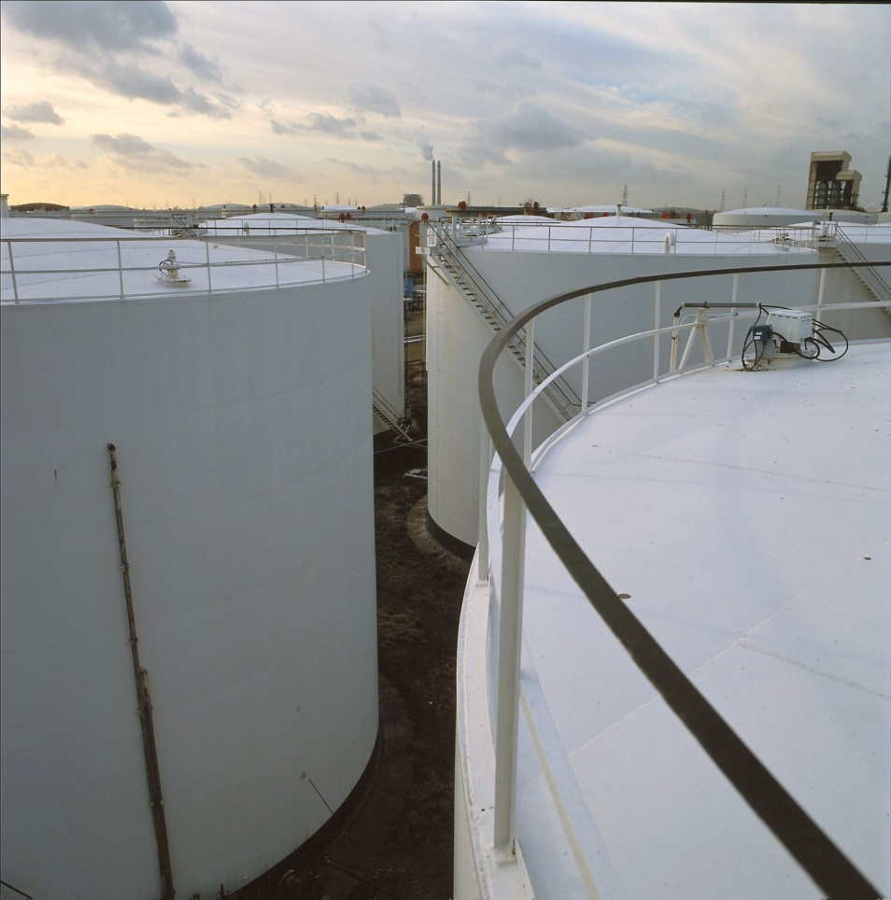
Tank Survey
Tank Connections
RTG nozzle
Disturbances
Inlet pipes
MST / WLS nozzle
Flanges for Pressure Transmitter
General information
Tank Distances
Where and how to install cables
Existing or new cable trays
Positions for Junctions Boxes
Notes:
What to look at on a TK survey.
Nozzles?
No disturbance’s?
Pipes?

Slide 11
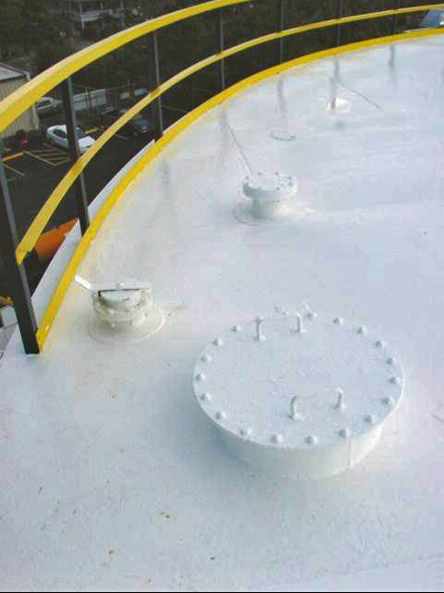
Tank connections
4” nozzle
Useful for MST/WLS
Hand dip
nozzle
20” nozzle
Useful for RTG with
parabola antenna

Slide 12

Tank distances
Hand Dip Nozzle
Tank reference
Gauge Nozzle
Dip plate
Tank zero reference

Slide 13
Tank distances
Gauge height
>G-dist<
Tank reference height
>R-Dist<
Min Level
(Extended measuring Range)
>C-Dist<

Slide 14
Gauge reference point
Parabola, Horn, Cone and fixed Array antenna
Top part of tank flange
Gasket should be included
Inclined and Hinged Array
Internal reference point available.
To be used as tank reference and gauge reference point.
G-dist = 0 (zero)
If tank reference belongs to additional pipe – use upper part of tank flange
Notes:
Where is the reference point on the radar?
See slide

Slide 15
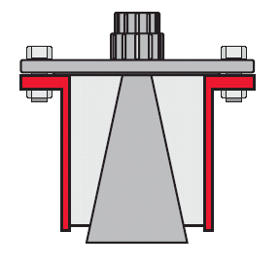
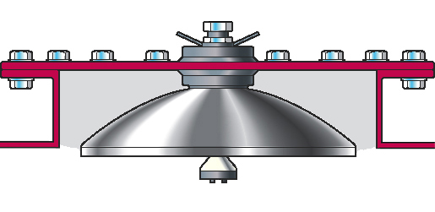
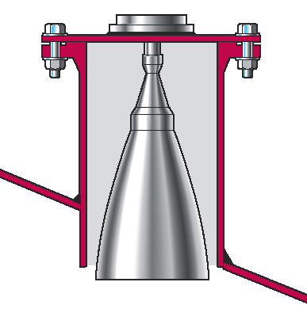
Gauge nozzle
Parabola 8” Cone Horn
Ø 441 mm
Ø 177 mm
Ø 189 mm
To secure measuring accuracy
its recommended that the antenna
ends outside the tank nozzle.
Notes:
Recommendations from us

Slide 16
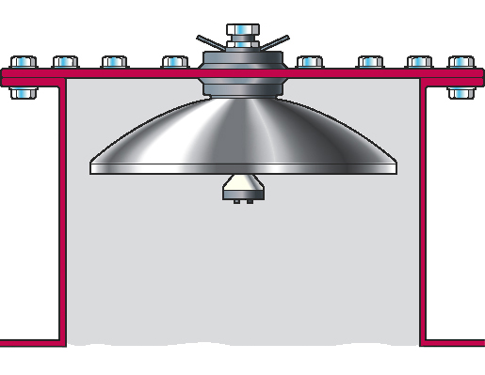
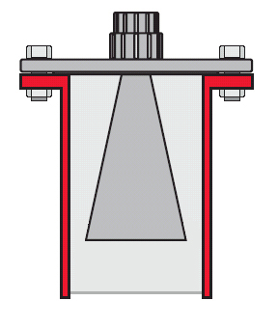
Gauge nozzle
For 20”Nozzle
max 500 mm
Max
330 mm
Beam angle
+5 º
Maximum nozzle height
relates to nozzle diameter.
A wider nozzle can also be higher
Max
525 mm

Slide 17
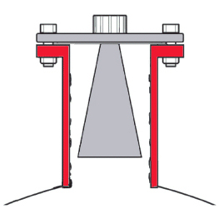
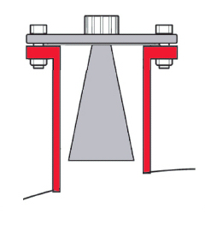
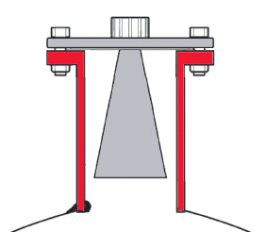
Gauge nozzle
Retrofit cases – accuracy might be affected
Antenna inside nozzle
Nozzle walls have to be clean
Try to avoid
Antenna inside nozzle
+ odd ending
The radar beam is
never allowed to “hit”
the nozzle walls
Antenna inside nozzle
+ welding
Notes:
Retro fit, what to think of!!!

Slide 18
Radar beam angle
Parabola = ±5°
Horn = ±15°
8” Cone = ±15°
Warning ! The radar beam might “hit” the tank wall and affect low level accuracy.
X / tan15° = Y
X
Y
Warning

Slide 19
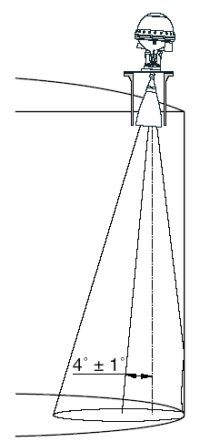
Gauge Installation
Parabola Inclination
1 - 1.5° towards tank centre
Horn Inclination
0° flange
4° flange
Select upon order

Slide 20
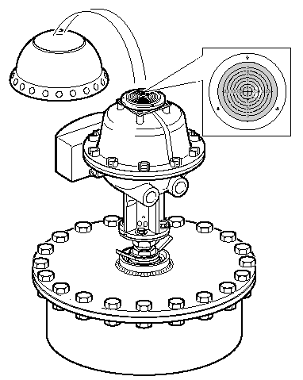
Gauge inclination
Parabola inclination with Inclination Device
1-1,5º
0º for bitumen
Note:
No inclination is available for
PRO with cone antenna

Slide 21
Direction of RTG
Direct RTG junction box towards tank centre within 2º to maintain highest measuring accuracy.
Notes:
Ok to have JB towards tank wall?
Yes, but it could be difficult to get access to JB….

Slide 22
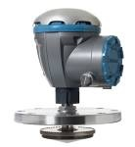
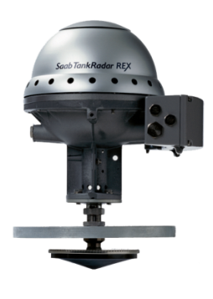
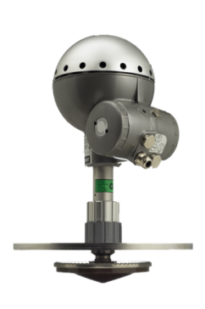
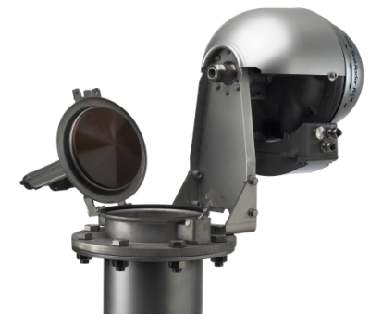
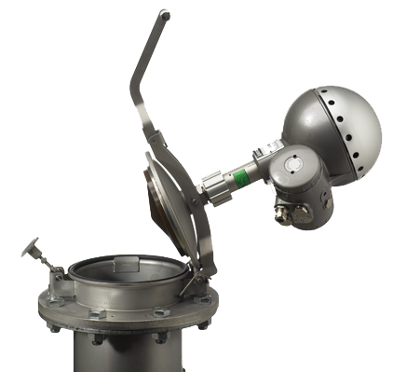
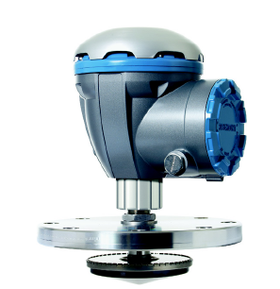
Still pipe – Array antenna
Fixed – Raptor, REX & PRO
Inclined – REX
Hinged – Raptor & PRO

Slide 23
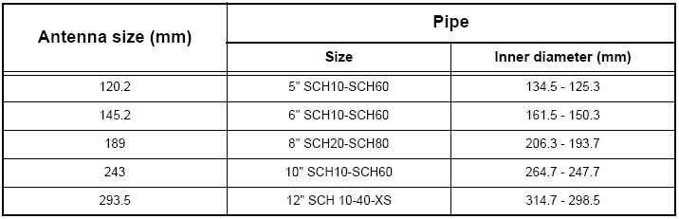
Disk dimension
Ø mm

Slide 24
Still pipe - requirements
Pipe should be straight and vertical
Holes
Should be without burrs
Every hole turned 180°
One hole must be above max fill level

Slide 25
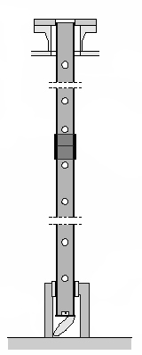
Still pipe
Pipe extension
Maximum gap 1mm
Clamped
Welded
Notes:
Two types

Slide 26
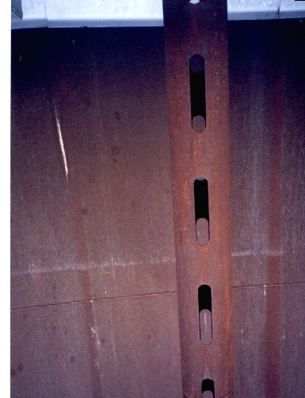
Slot dimensions
Pipe Diameter Max Slot area
5” 0.1 m²
6” 0.1 m²
8” 0.4 m²
10” 0.8 m²
12” 1.2 m²
Bigger slots can result in a loss of accuracy and measuring problems at long distance (low levels)
Total no. of slots
Slot Area
Notes:
Demand on maximum slot area

Slide 27
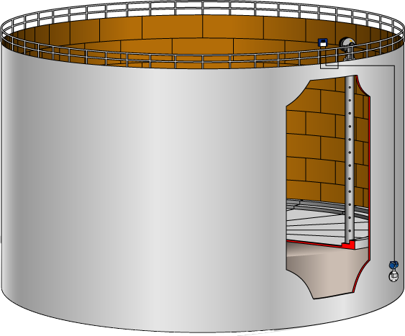
A pipe
During a site survey one set of
floating roof tanks were found,
Tank details:
R-dist = 14,577 meter
Max fill level = 12,250 meter
Pipe diameter = 8 inch schedule 40
Slots on both sides
250*25 mm
4 slots per meter
Can this pipe be used?
What will be the maximum length of a pipe with these slots be?

Slide 28
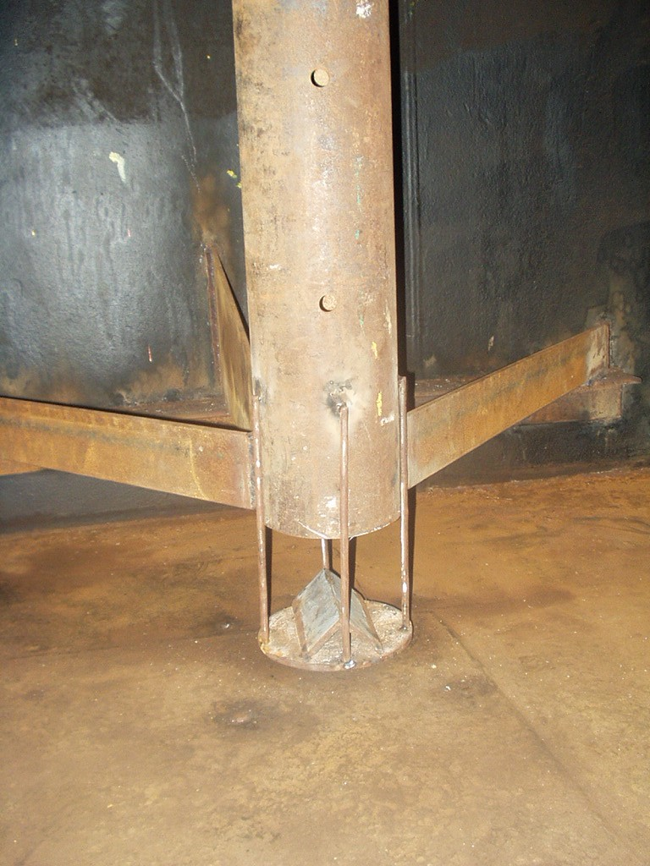
Pipe end
Datum plate construction
Deflection plate to minimize bottom echoes and make it possible to maintain high accuracy at low levels.
Old pipes
No datum plate
Valid reference point missing.
No deflection plate
Measurement problems can appear at low levels if ‘light’ product (low density).
Hand-dip
No Hand-dip
Notes:
If handdip allowed the left plate can ONLY be used, otherwise both are ok

Slide 29
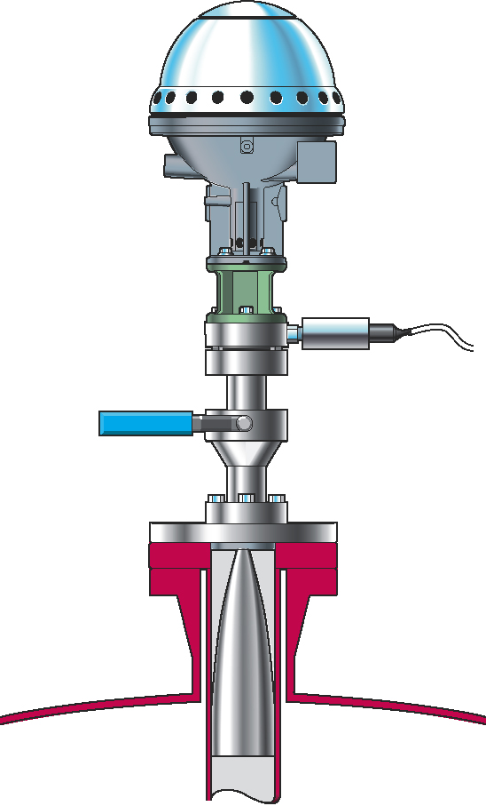
Mechanical Requirements
3960
Pressure sensor for vapour
Safety ball valve
4” or 100 mm
SS Still pipe
Maximum fill level
Cone end +500 mm
Notes:
SS=Stain steel

Slide 30
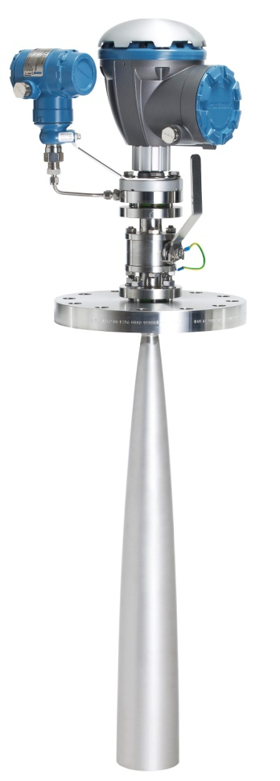
Mechanical Requirements
5900S LPG/LNG Antenna
Reference echoes
Verification pin mounted in still-pipe hole
Deflection plate with verification ring at the lower pipe end
Optional pressure sensor
Fire-proof Ball Valve
Minimum 1200 mm to product surface for highest accuracy
Minimum 800 mm with reduced accuracy
Notes:
Vapor pressure sensor enables volume correction due to vapor for best measurement performance.

Slide 31
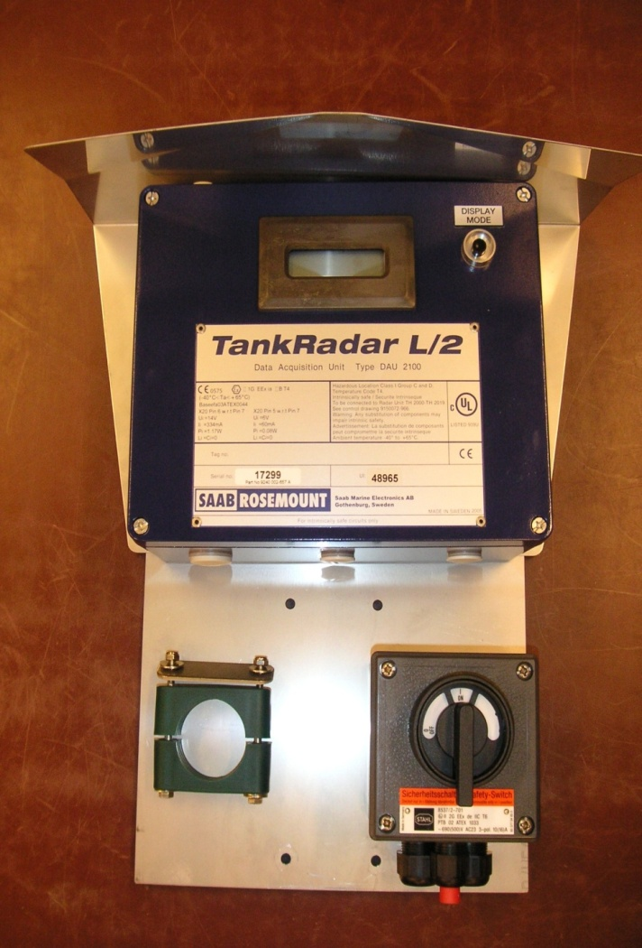
Weather protection
Roof and mounting plate for SDAU, RDU and DU2210.
Mounts on 2,5 inch pipe
Place for safety switch (included from RTR)
Drawings available from GSP
Notes:
Optional stuff!!

